Slide 1
Core Java

Slide 2
Syllabus
Introduction & Installation- James Gosling
Features
Modifiers and Variables
Data Types & Conversions
Operators
Control Statements
Class, Object & OOPS
Exception Handling
Collections

Slide 3
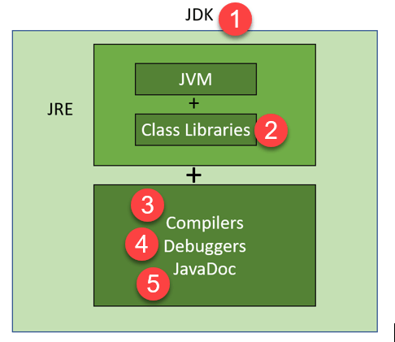
JVM, JRE, JDK
JVM- Java Virtual Machine (to check the Java standards of code)
JRE – Java Runtime environment
JDK – Java development kit

Slide 4
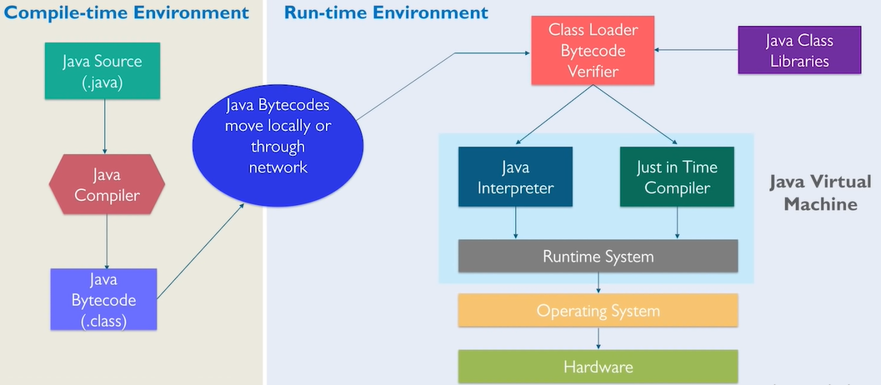
Java Working
Java code(.java) -> Compiler -> Bytecode(.class)->JVM ->OS(output)

Slide 5
Features
Simple – less mem wastage
Object oriented
Platform independent – write once and run anywhere
Portable – work with any OS
Robust – Good mem mgmt(heap), good exception handling
Secure – security mgr inside JVM, JAAS middleware
Dynamic – mem allocation at run time
Distributed – to create client-server app
Multithread

Slide 6


Basics
Object – Instance of the class. State and behavior.
Class - structure(blueprint) of an object.
Identifiers : name assigned to elements like classes, variables &methods.
Method : block of code or collection of statements(reusability).
Constructor- is a block of codes similar to the method. It is called when an instance of the class is created.
Default Constructor
Parameterized Constructor

Slide 7
Modifiers & Variables
Modifiers: Changes or modifies the meaning of another word.
Access control modifiers:
Public - Visible to everywhere
Default – Visible to package
Private – Visible to class only
Protected – Visible to pkg and its all subclasses
Non-Access modifiers:
Static – calling methods and variables without an obj .
Final - finalizing the implementation of classes, methods and variables.
Abstract – creating abstract classes and methods.
Synchronized and volatile – used for threads.
Variables:
Local
Instance
Class/static

Slide 8
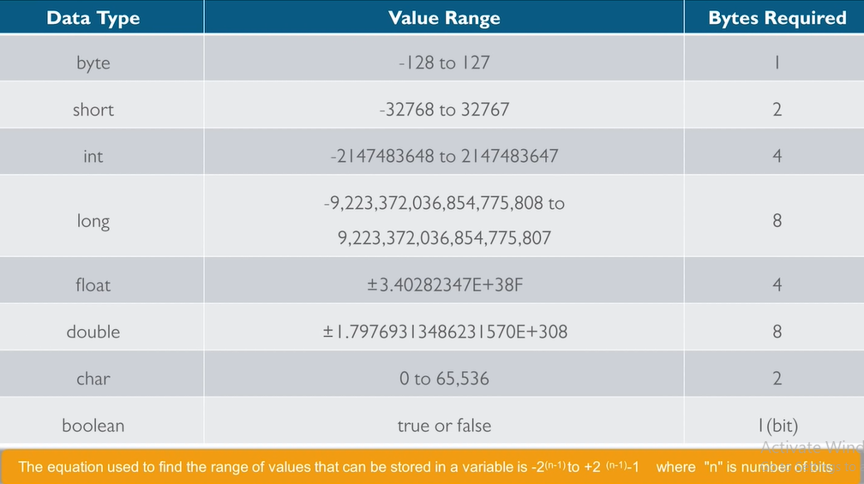
Datatypes & Conversions
Primitive Data Types:

Slide 9
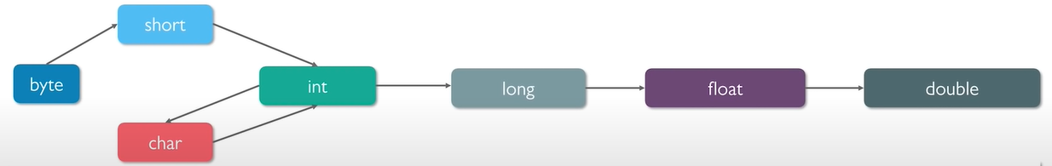
Datatypes & Conversions
Non-Primitive Datatypes: Which includes Classes, Interfaces and Arrays, String rtc.,
Conversions in Primitive DT
Implicit – convert lower DT to higher DT
Explicit – convert higher DT to lower DT
Type Conversion methods(primitive non-primitive )
String to int : Integer.parseInt()
String to Integer : Integer.valueOf()
Int to String : Integer.toString() or String.valueOf()
String str = “Hello”
str
Heap

Slide 10
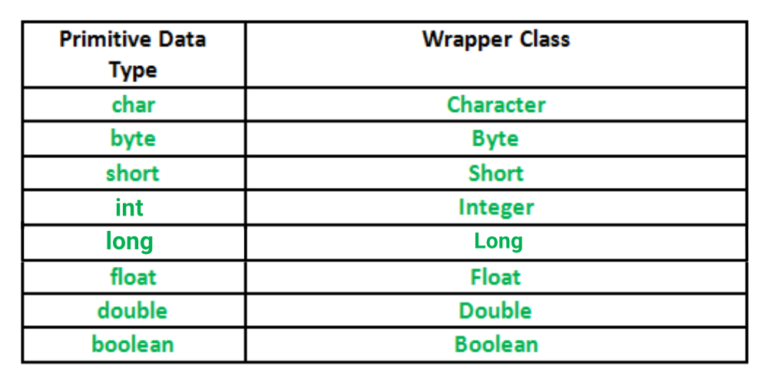
Wrapper Class
Wrapper Class : A class whose object wraps or contains primitive datatypes.

Slide 11
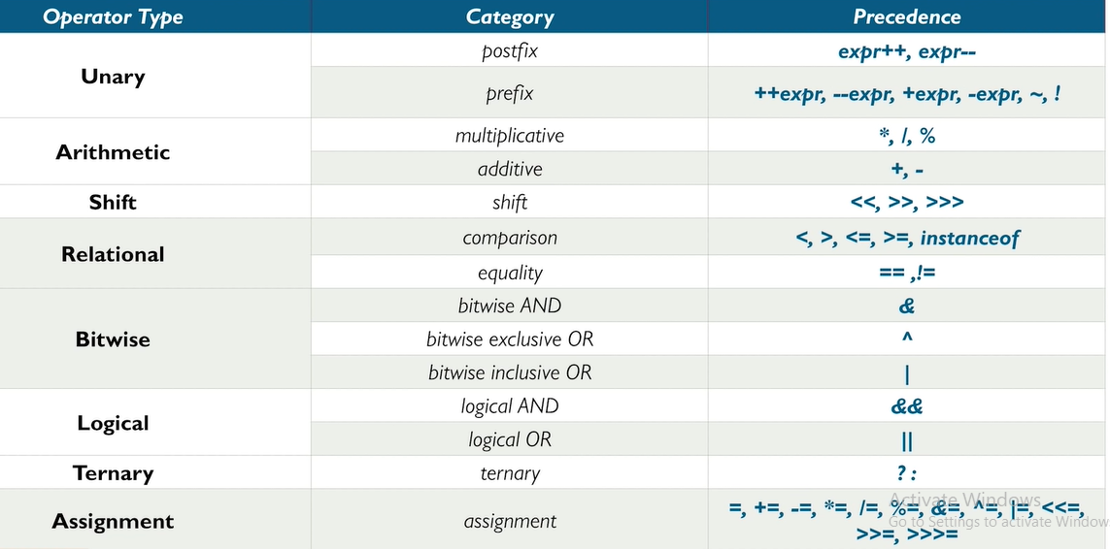
Operators

Slide 12
Control Statements
Control Statements
Decision making statements
Iteration statements
Jump statements
If-else
switch
for
while
Do-while
break
continue

Slide 13
Control Statements
Decision making Statements:
If statement
Simple If statement
If-else statement
If-else-if ladder
Switch statement : allows a variable to be tested for equality against a list of values.
Loop statements
For loop
Simple for
For-each : to traverse the array or collections.
While loop : to iterate a program several times when the no of iterations is not known.
Do-while loop: to execute the code once irrespective of condition.
Jump statements
Break : breaks the current flow of execution at specified condition.
Continue : to skips the code at specified condition and jump to next iteration.

Slide 14
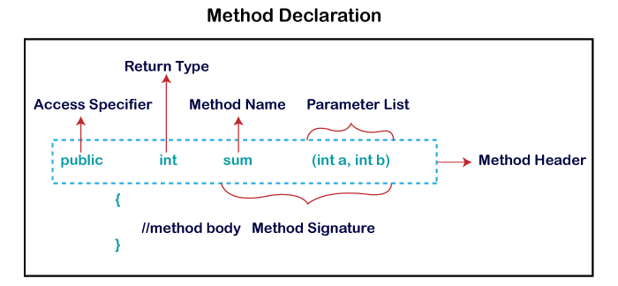
Method
Method:
Predefined – main, print
User-defined
Static method
Instance method
Accessor method : reads the instance variable(s) and returns the val of private field.
Mutator method : read and modify the instance variables and don’t return anything.

Slide 15
This & Arrays
This keyword:
To refer the current class instance variable.
To invoke current class method.
To invoke current class constructor.
Arrays:
A collection of similar type of elements
0 1 2 3 4 5 6 7 8
Elements are accessed by its index.
Array size is fixed and can not be changed.
Int [] a= new int[5]; int [] a ={1,2,3,4,5}

Slide 16
Strings
It is an object which represents the sequence of char values.
String is immutable.. By using StringBuilder we can make mutable.
Concatenate by using +, concat(), StringBuider append(), String.join().,
We have many methods substring(), trim(), split() etc.,
String st = “tutorial”
String st1 = “tutorial”
String str = new String(“ tutorial”)
tutorial

